Slide 1


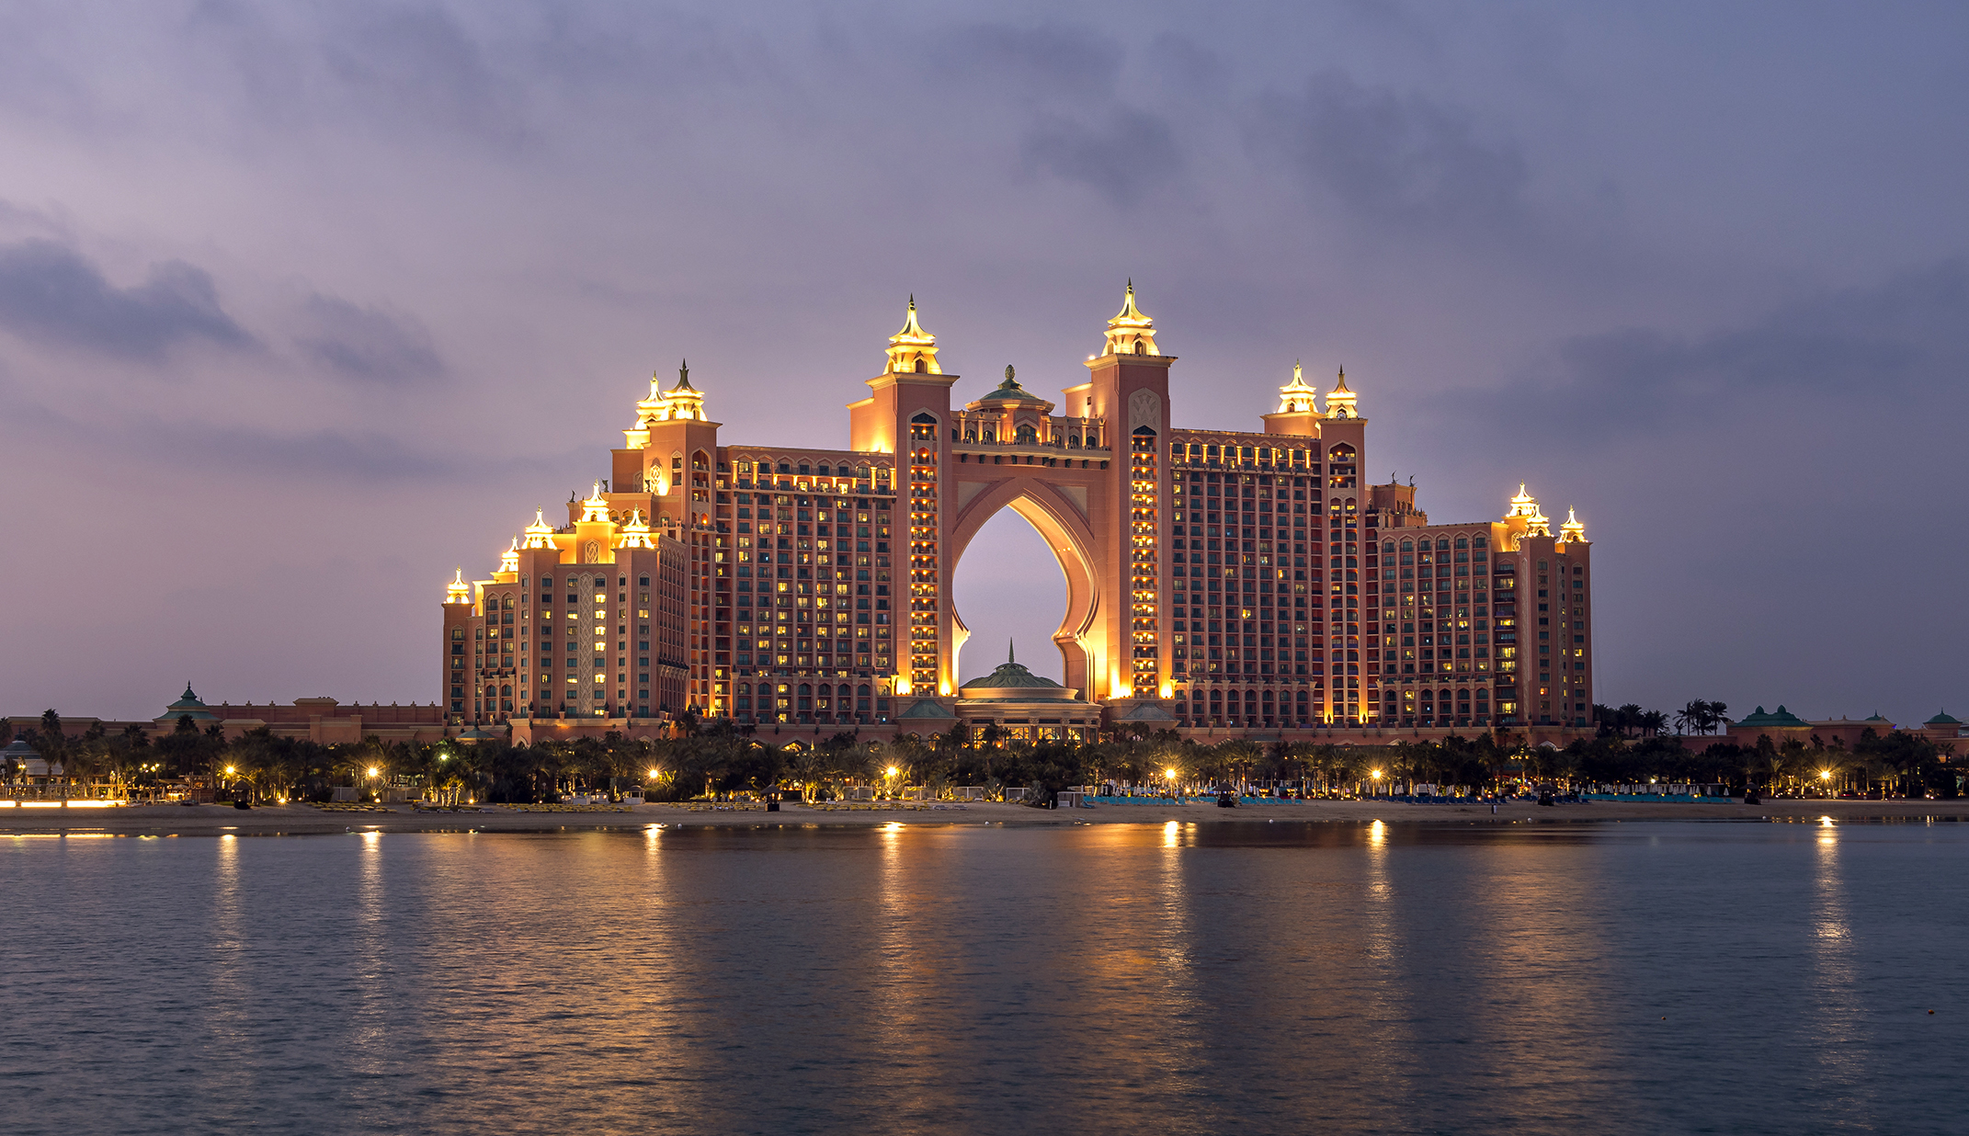













Slide 2
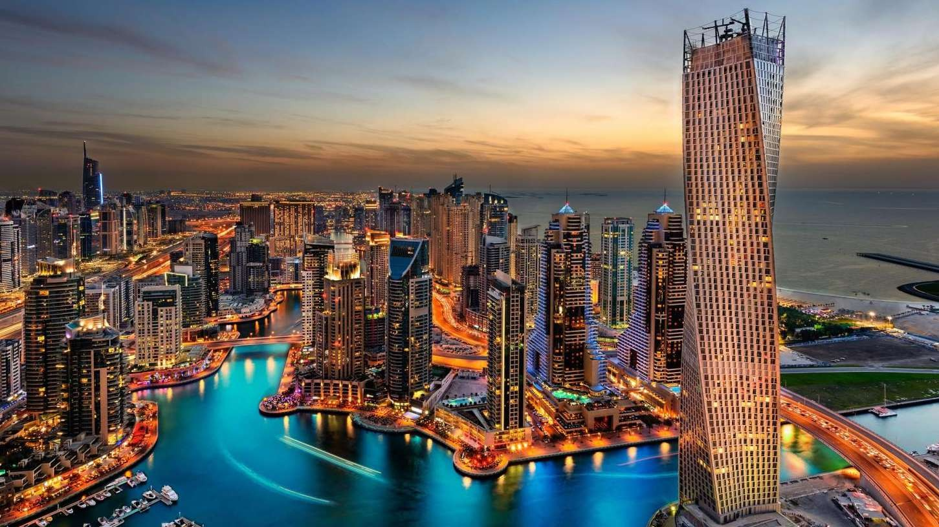
LEARNING FUTURE CONCLAVE & AWARDS (LeFCA),
DUBAI, 2023

Slide 3
LEARNING FUTURE & AWARDS CONCLAVE
VENUE: HOTEL ATLANTIS DE PALM, DUBAI

Slide 4

WHAT?
World’s largest and most high-profile education summit & awards, deciphering the contours of the future of learning world-over, post-pandemic
WHERE? WHY?
Atlantis de Palm Hotel, DUBAI
Middle of the World in a way.
Middle of Asia and Africa, most happening continents at this moment.
WHEN?
15-16-17 March, 2023 (Wed-Fri).

Slide 5
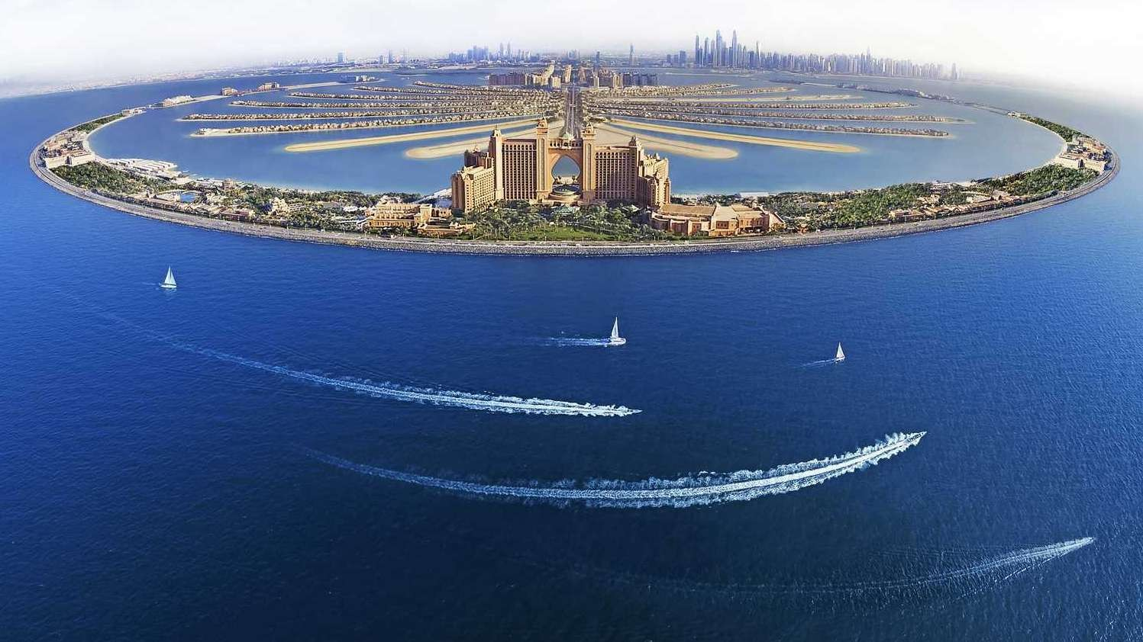

WHY THIS
(A) Education has gone through a revolutionary change due to the pandemic and its aftermath owing to disruption in earlier paradigms of learning.
(B) Technology leapfrogging is paramount now and is ushering in a new universe of learning, with challenges of digital divide evident too.
(C) Informal and diverse educational routes have come to stay. Alternative learning, home schooling, open education etc are becoming common place today.
CONCLAVE?

Slide 6
WHY THIS
Old silos and buckets of education are crumbling. Universities and people are clubbing hitherto unseen combinations of subjects, like engineering and music together.
Degree and Qualifications are being superseded by skills and attitudes often, and skills are diversifying to hard, soft, life, and spiritual skills. EQ is taking precedence over IQ.
Layers and levels of education and training are very different in different economies. And any-time entry and any-time exit from learning with no credits lost of the past is fast becoming the norm.
CONCLAVE?

Slide 7
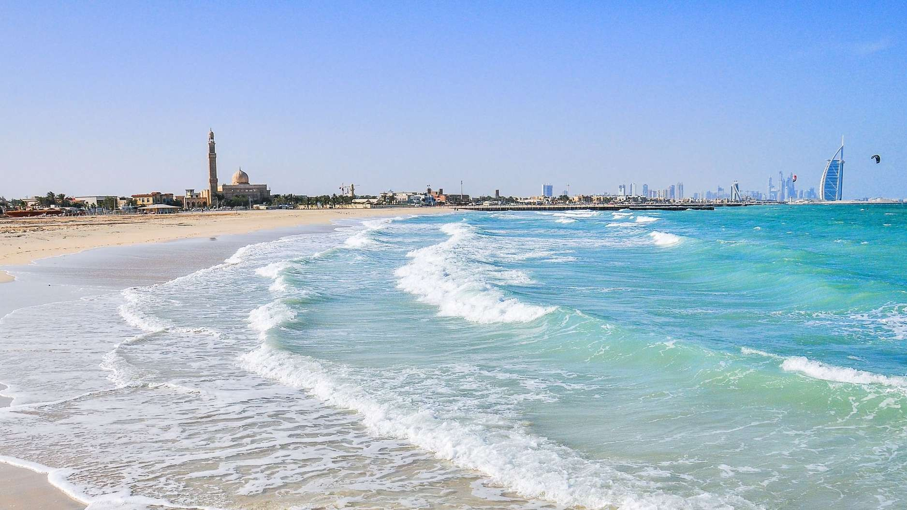
WHY THIS
Knowing, sharing best practices & ways to raise investments in education are today real caring, and a must for humanity to face the humongous challenges of learning and sustainability challenges ahead.
Awarding the best practices and putting those and some educationists along with institutes as role models before the educational world is an important step to boost better learning.
CONCLAVE?

Slide 8
OUTCOMES
Best practices to be shared with all in the same domain.
Best Technologies available in education to be showcased.
Strategic tie-ups among institutes, organizations, tech companies, investors and entrepreneurs to evolve.
Emerging futuristic learning concepts to be presented to a global audience.
Application, employability & innovation oriented education explored.
Best rating, ranking and benchmarking of schools to universities to evolve specifically in the Afro-Asian world developing world.
OF THIS CONCLAVE?

Slide 9


























PARTNERS IN THIS CONCLAVE?
MAIN ORGANIZERS
EDUCATIONAL (Proposed)
CORPORATE (Proposed, some contacted)

Slide 10

FOCUS AREAS
OF DISCUSSIONS:
Blended Learning
Cognitive Learning
Alternative Learning
Open Learning
STEAM Learning
Praxis in Education
Mentoring Mode
Flipped Classroom
Proprietary Content
Aggregated Content
Visual Communication in Learning
Infographics in Education

Slide 11

FOCUS AREAS
OF DISCUSSIONS:
Inclusive Pedagogy
Project-based Learning
(O) Experiential Brick & Portal (P)
(Q)
(R)
(S)
(T)
(U)
Learning to Learn/ Self-Learning Organic Learning
Open Book Assessment Case-study Evaluation Problem-solving Assessment
Formative-Summative Evaluation
IQ-EQ-PQ Convergence
4IR Technologies & Skills
(X) Higher Order Skills (Y)
(Z)
AI-ML Driven Learning
AR-VR-XR Applications in Learning

Slide 12
PROGRAM
O U T L I N E

Slide 13


















FRIDAY: DAY 1 : MARCH 15, 2023
9am:
Inaugural of Exhibition of Best Educational Providers:
Schools to Universities (formatted exhibition), and edtech companies, banks, automobiles, computers & IT majors, etc.: Minimum 800 exhibitors: with EXHIBITOR CONTESTs.
10am:
Inaugural Session: Visionaries of Global Learning UAE Prime Minister/ Education Minister,
UNESCO Global Director General/ Asia Head,
UNICEF Global Director General/ Asia Head, IAU President,
Oxford/ Cambridge ProVost/Dean
Vision Statement by AUAP President,
Moderated by LeFCA Convener, Welcomed by LeFCA Director.
A Tech Sponsor’s (like, Adobe/Amazon): An Illustrated Presentation.

Slide 14

DAY 1 CONTINUES…
1130am:
Panel 1: World’s Best School Education Leaders’ Panel NAIS President,
British International Schools Group President, | Sanghai Community International School Principal, Ram Krishna Mission General Secretary,
Singapore American School Principal, etc. (max 5). Moderated by a leading Education Journalist/Editor. A Tech Sponsor’s Illustrated Presentation.
1pm to 3pm: Lunch & Networking

Slide 15

DAY 1 CONTINUES…
3 TO 4:30pm:
Panel 2: Global School Board Chiefs: Leaders in School Education Regulation & Management: Challenges & Measures Taken in Post-Pandemic School Education
International Baccalaureate, Cambridge Board,
Oxford School Board, KHDA UAE,
CBSE India,
International Primary Curriculum Chief,
International General Certificate of Secondary Education President.
Moderated by an Educational Journalist/Editor. A Tech Sponsor’s Illustrated Presentation.

Slide 16
DAY 1 CONTINUES…
5 TO 6pm:
Case-studies 1: Distance Learning, Open Schooling & Home Schooling: Alternative Education: 4 best case studies from four different nations: 15 minutes, with videos.
Cases of Khan Academy (USA) K12.com (US)
Confucian Work & Homeschooling (China) OER Africa (Kenya)
Thailand Alternative School, Thailand
Presentation of World Teen Parliament Founder: the Concept, the Outcome, the Promise Ahead.
A Tech Sponsor’s Illustrated Presentation (Byju’s).
6:30 TO 830pm:
Award Show 1: Best School Awards (Afro-Asian schools).
830pm to 10:30pm: Drinks and Dinner.

Slide 17

DAY 2: Thursday, 16, 2023
9am TO 10am:
Panel 3: Best Ranking and Rating of Universities & t he Changing Models in Post-pandemic Education
QS Ranking,
Times Higher Education Rating-Ranking,
NIRF India,
Sanghai Ranking: Global or Asian Heads of these bodies to speak.
LeFCA Rating-Ranking Model to be presented by LeFCA Convener.
A Tech Sponsor’s Illustrated Presentation.

Slide 18
DAY 2 CONTINUES…
12 to 1pm:
Panel 4: Blended Education Policy, Models & the Future Learning: nations with declared blended education policies to be represented by their ministers/secretaries (4 countries to be represented)
Bangladesh Blended Education Policy (Minister of Education)
UGC Chairman, India (New Education Policy & its application with regards to Blended Education)
Singapore Government Blended Learning (minister or top bureaucrat)
South African Blended Learning (Minister or top bureaucrat)
Moderated by LeFCA Convener.
A Tech Sponsor’s Illustrated Presentation (EduTech Company aiding Blended Learning)
1pm to 2pm: Lunch and Networking
11am to 12 noon:
Case-studies 2: Sustainability Impact of Higher Education: 4 good case-studies from four nations to be presented, with videos to showcase sustainability initiatives on campus. Western Sydney University, Australia
King Abdulaziz University, Saudi Arabia Daffodil International University, Dhaka, Bangladesh
Universiti Sains Malaysia, Malaysia Aswan University, Egypt
Shoolini University, Shimla, India
Moderated by LeFCA Director.
A Tech Sponsor’s Illustrated Presentation (Sponsor from Waste Management/ Sustainability sector).

Slide 19

DAY 2 CONTINUES…
3 to 4pm:
Challenges and Solutions for Lifetime Learning, and Learning beyond Degrees: 4 Best cases with videos from four nations focused on
non-degree quality education & training initiatives.
Swaraj University, India
UNESCO Institute of Lifelong Learning,
Germany
Makerere University Institute of Adult and Continuing Education, Kampala, Uganda
Indira Gandhi National Open University,
India
ASPBAE: Adult Education & Lifelong Learning in the Asia South Pacific
A Tech Sponsor’s Illustrated Presentation.
2 to 3pm:
Case-studies 3: Creative & Liberal Education Futures: Five case-study based Talks with videos from:
Fashion: Fashion Institute of Technology, US OR London College of Fashion, UK
Design: National Institute of Design, India OR School of Arts, Design & Architecture, Finland
Films: Whistling Woods International, India OR New York Film Academy, NYC, US
Performing Art: Juilliard School, US OR Indonesia Institute of Arts Surakarta, Indonesia
Liberal Arts (Ashoka University, India), OR University of California Los Angeles (US), OR Deakins University (Australia)
Top five universities from the above in these fields to speak here. A Tech Sponsor’s Illustrated Presentation.

Slide 20
DAY 2 CONTINUES…
5 to 6pm:
Case-studies 5: Technology & Medical Education take a Leapfrog post pandemic
2 best Tech Schools and 2 best Medical Schools make video and talk-based cases:
MIT/Caltech/Nanyang Technology/Tsinghua for Engineering; John Hopkins/Stanford/Baylor/UCL/Imperial College in Medicines.
A Tech Sponsor’s Illustrated Presentation.
630 to 7pm: Valedictory Talks: Any ONE:
Ken Robinson, British Author, Most viewed TED Speaker, UK
Kailash Satyarthi, Nobel Peace Prize Winner, India
7pm to 8:30pm:
Award Show 2: Higher Education Awards 8:30pm to 11pm: Drinks and Dinner
4 to 5pm:
Panel 5: Business Education in the Post-pandemic VUCA World
Dean, INSEAD Business School, France Asian Institute of Technology, Thailand Indian Institute of Management, Kolkata/Ahmedabad
Indian School of Business, Hyderabad Dean, School of Business, Yale University Dean, Kellogg’s Business School
Dean, Harvard Business School
North South University/ BRAC Univ, Bangladesh
Moderated by a leading editor of a Business Daily Newspaper
A Tech Sponsor’s Illustrated Presentation.

Slide 21
DAY 3: MARCH 17, 2023: Special Funding & Employability Focus
11am to 1230pm:
Panel 6: Education Funding & Cash-flow Management in the Post-pandemic world
2 Banks Directors & 2 Fund Managers & 2 Venture Capitalists to speak: those who have funded education prominently
Moderated by a leading editor of a Business Daily Newspaper
A Tech/ Banking Sponsor’s Illustrated Presentation.
Closing Session: 1230 to 130pm OPEN MIC Session: Feedback & Suggestions
Lunch: 130pm till 330pm.
Exhibition Continues till 7pm.
9 to 11 am:
Case-studies 6: Best Practices in Employability & Entrepreneurship Generation in Higher Education
2 Business Schools, 2 Liberal Arts Schools, 2 Technology Schools, 2 Law Schools, 2 Creative Schools of Repute: Asian, African, European Mixed.
Each for 10-12 minutes
LeFCA Director to Moderate

Slide 22
MARCH 18-19, 2023: Saturday-Sunday:
Organizing One/Two Day-long tour:
Dubai City
Desert Safari
UAE Tour (other locations outside Dubai)
To be booked in advance, as per given rate-chart, and these are optional for participants

Slide 23
SEGMENTS of the Conclave:
Expo: Schools, Universities, EdTech Companies
Learning Exhibition: Exhibition of Pedagogies across the World
Thematic Panel Discussions
Thematic Case-studies
Awards for Afro-Asian Education under the following categories:
University Education
School Education
Alternative Education

Slide 24














RATING-RANKING
By Geography
On Some Rating Parameters
With Rating Weightages
With Ranking Types
Separate Jury: Schools
Separate Jury: Universities
With 500+ Schools Nomination
With 500+ University Nomination
Data of institutes & Perceptions
With Disclaimers
AWARDING

Slide 25



















RATING-RANKING
(A) Mentoring, Structured Learning, Pedagogy, Organic Learning,
Intellectual Capital
Research, Applications, Patents,
Publications, Consultancy
Employability, Jobs, Entrepreneurship,
Incubation, Projects
Social Outreach, Change Initiatives & Impact, Sustainability (SDGs Compliance)
External Perception
PARAMETERS FOR HIGHER EDUCATION
(UNIVERSITY)
Each parameter is of 20 marks, total 100 marks.

Slide 26






RATING-RANKING
Mentoring, Learning, Pedagogy,
Performance, Intellectual Capital
Innovation, Experimentation, Organic Learning
Holistic Growth (Culture, Sports, Life Skills)
Social Outreach, Change Initiatives & Impact, Sustainability (SDGs Compliance)
External Perception
Each parameter is of 20 marks, total 100 marks.
PARAMETERS FOR SCHOOL EDUCATION

Slide 27
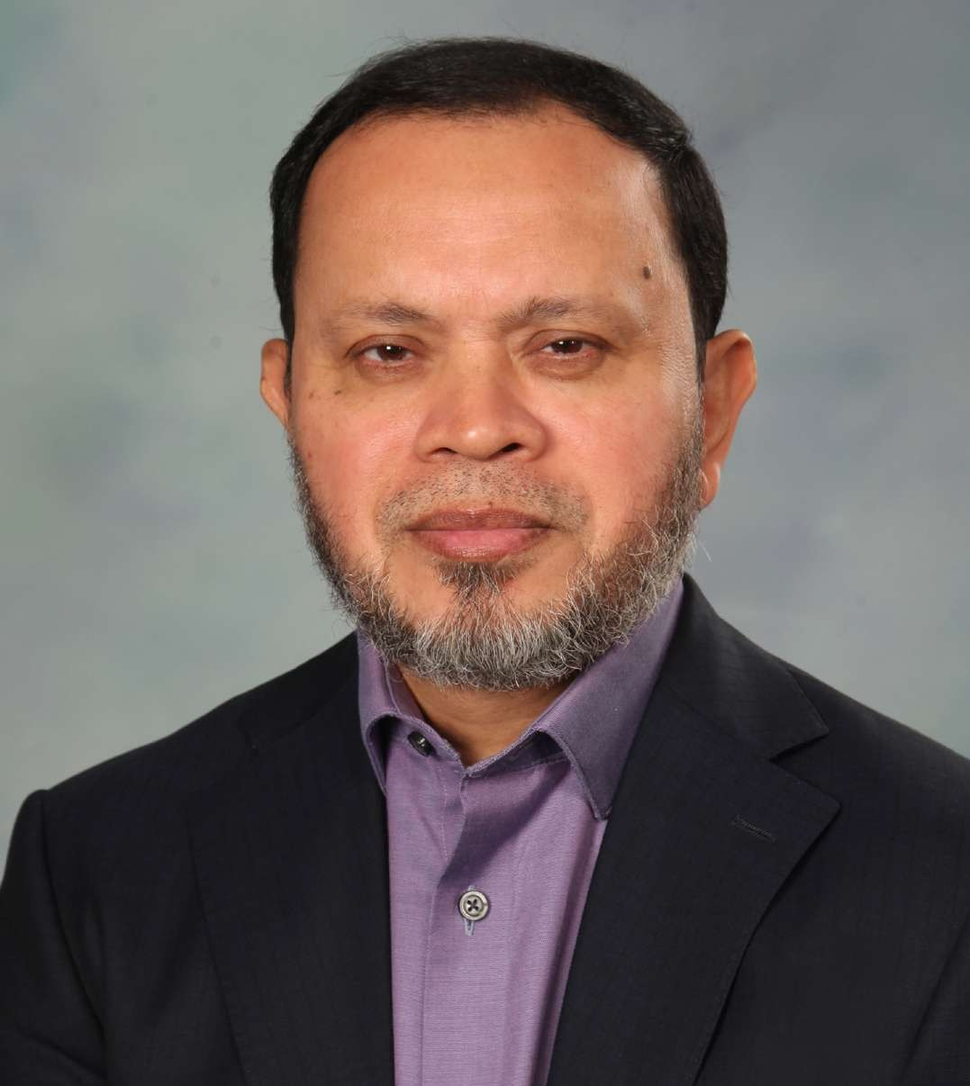
LeFCA Patron & Chairman
Dr. SABUR KHAN
President AUAP, Chairman, BoT, DIU

Slide 28
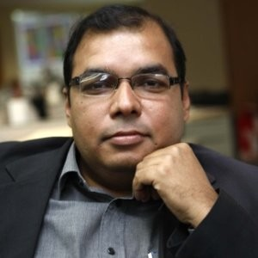
LeFCA Director
Mr SAIFUR RAHMAN
Founder & CEO,
PanAsia Group, Dubai, UAE

Slide 29
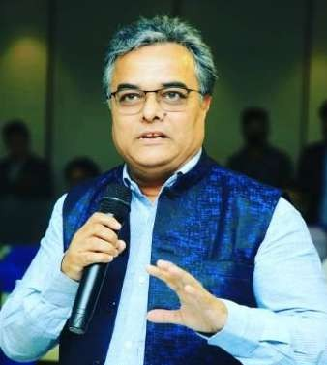
LeFCA Convener & Curator
PROF UJJWAL ANU CHOWDHURY
Higher Educational Strategist & Professor;
Has been associated with various universities like Daffodil (Bangladesh), Adamas, Amity, Symbiosis (India) & Amsterdam Film School

Slide 30
THANKS

